Slide 1
Joints of the Upper Limbs
By
NELSON OGUNGU
Department of Human Anatomy, JKUAT

Slide 2
Outline
Type of joint
Articulation
Joint capsule
Synovial Membrane
Bursae
Ligaments
Possible movements-mms

Slide 3
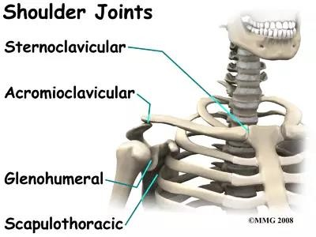

Slide 4
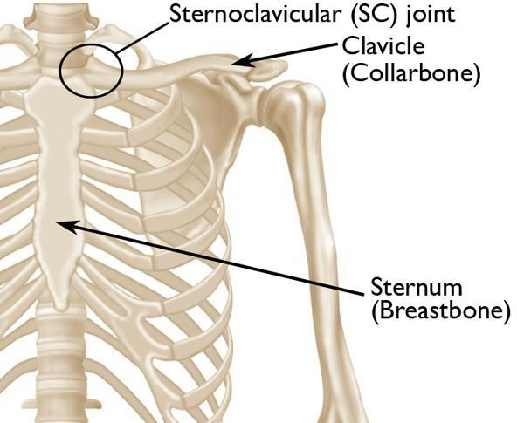
Sterno-Clavicular Joint
1. Type of Joint
Is a Synovial plane joint that serves as the primary skeletal connection between the axial skeleton and the upper limb.

Slide 5
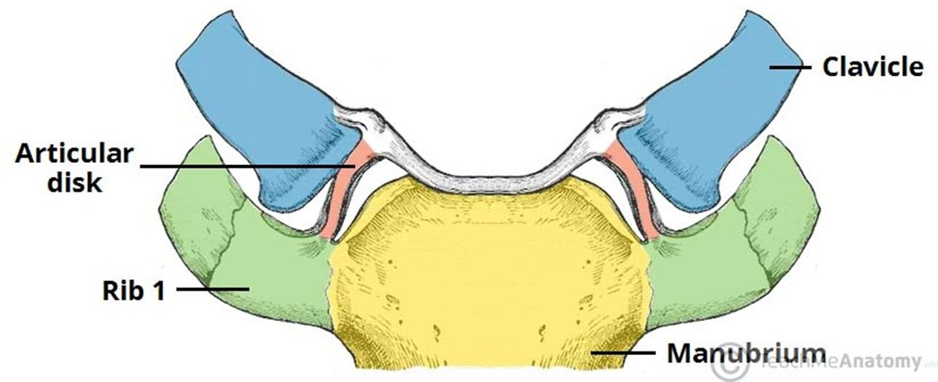
2. Articulation
Occurs between the medial aspect of the clavicle and the manubrium of the sternum.
A flat fibrocartilaginous disc lies within the articular surfaces

Slide 6
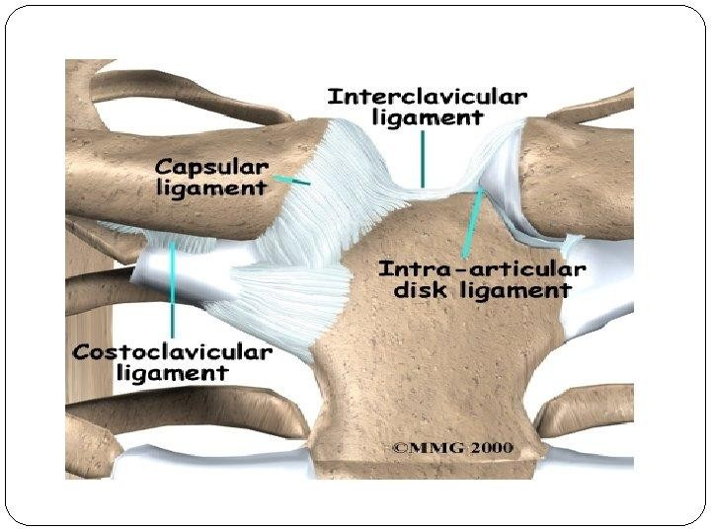
3. Capsule of the joint
This surrounds the joint and is attached to the margins of the articular surfaces.
The capsule surrounding the joint is weakest inferiorly, while it is reinforced on the superior, anterior and posterior aspects by the various ligaments.

Slide 7
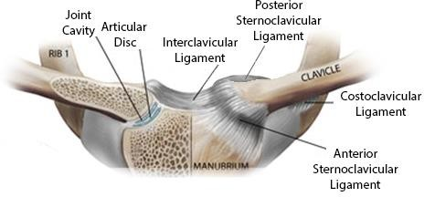
4. Synovial membrane
This lines the capsule and is attached to the margins of the cartilage covering the articular surfaces.
5. Ligaments
The capsule is reinforced in front of and behind the joint by the strong sternoclavicular ligaments.
Accessory ligament
The costoclavicular ligament is a strong ligament that runs from the junction of the first rib with the first costal cartilage to the inferior surface of the sternal end of the clavicle .

Slide 8
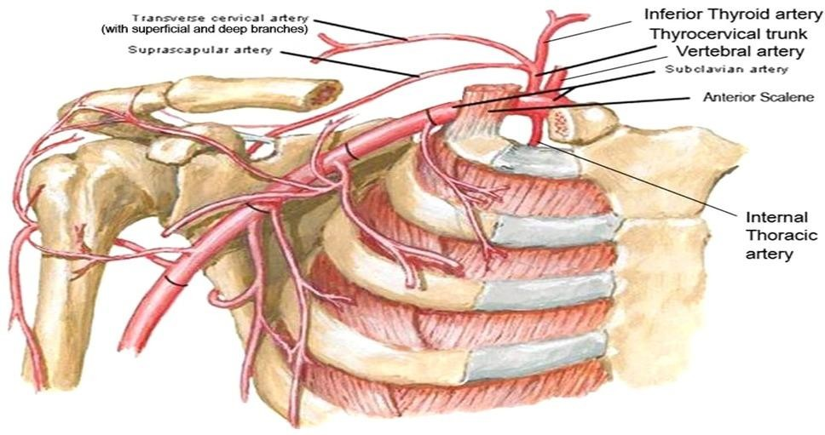
6. Blood Supply
Is derived from the internal thoracic artery and suprascapular artery.
Both arteries are branches of the subclavian artery.

Slide 9
6. Nerve supply
The supraclavicular nerve and the nerve to the subclavius muscle
7. Possible Movements
Forward and backward movement of the clavicle takes place in the medial compartment.
Elevation and depression of the clavicle take place in the lateral compartment

Slide 10
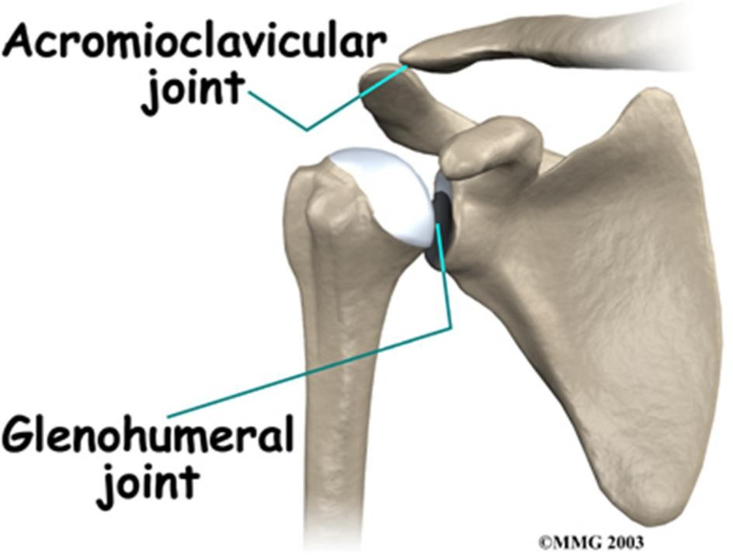
Acromion-Clavicular Joint
1. Type of Joint
Is a Synovial plane/gliding or arthrodial joint
Articular surfaces of the bones are flat or nearly flat, enabling the bones to slide over each other.

Slide 11
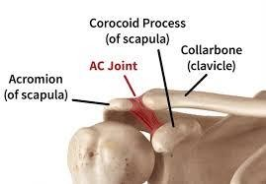
2. Articulation
This occurs between the acromion of the scapula and the lateral end of the clavicle .

Slide 12
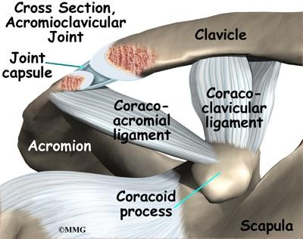
3. Capsule
The capsule surrounds the joint and is attached to the margins of the articular surfaces.

Slide 13
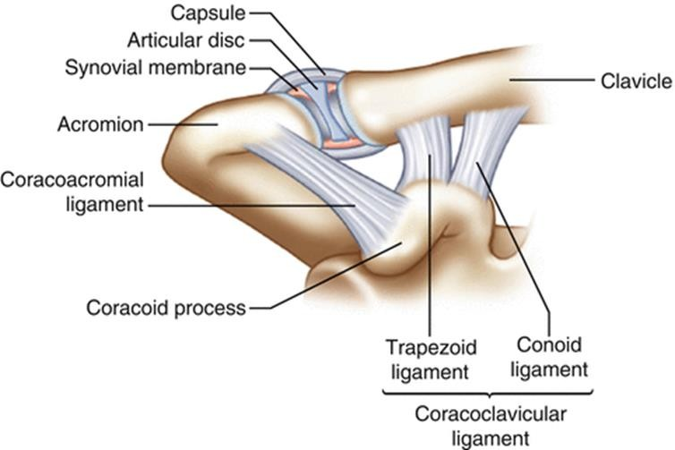
4. Synovial membrane
This lines the capsule and is attached to the margins of the cartilage covering the articular surfaces.

Slide 14
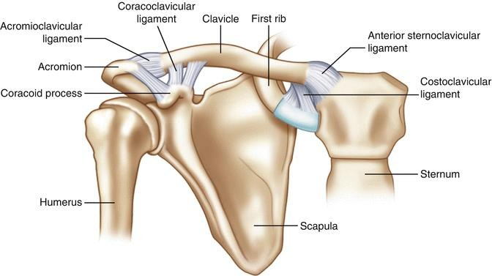
5. Ligaments
Superior and inferior acromioclavicular ligaments reinforce the capsule; from the capsule.
Accessory ligament
A very strong coracoclavicular ligament extends from the coracoid process to the undersurface of the clavicle
It is largely responsible for suspending the weight of the scapula and the upper limb from the clavicle.

Slide 15
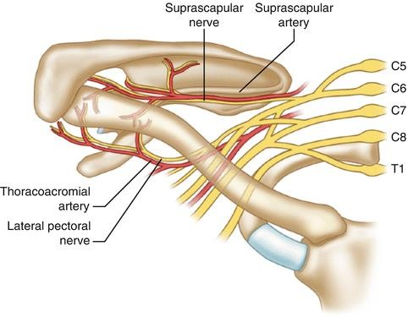
6. Blood Supply to the acromion-clavicular joint
Blood supply comes from the thoracoacromial (axillary artery), and suprascapular arteries (subclavian artery via thyrocervical trunk).
7. Nerve supply
Is by suprascapular nerve

Slide 16
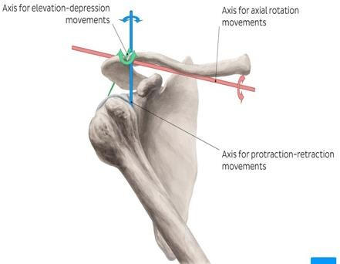
8. Possible Movements
The AC joint is a multiaxial joint which has three degrees of freedom;
1.Protraction - retraction 2.Elevation - depression (total range
of motion 15°)
3.Lateral rotation - medial rotation (total range of motion 30°)

Slide 17
The Shoulder Joint/ Glenohumeral Joint
Is one of the largest and most complex joints in the body because;
It allows the greatest range of free moment compared to the other joints in the body
It has a series of complex muscles and ligaments that keep it in place

Slide 18
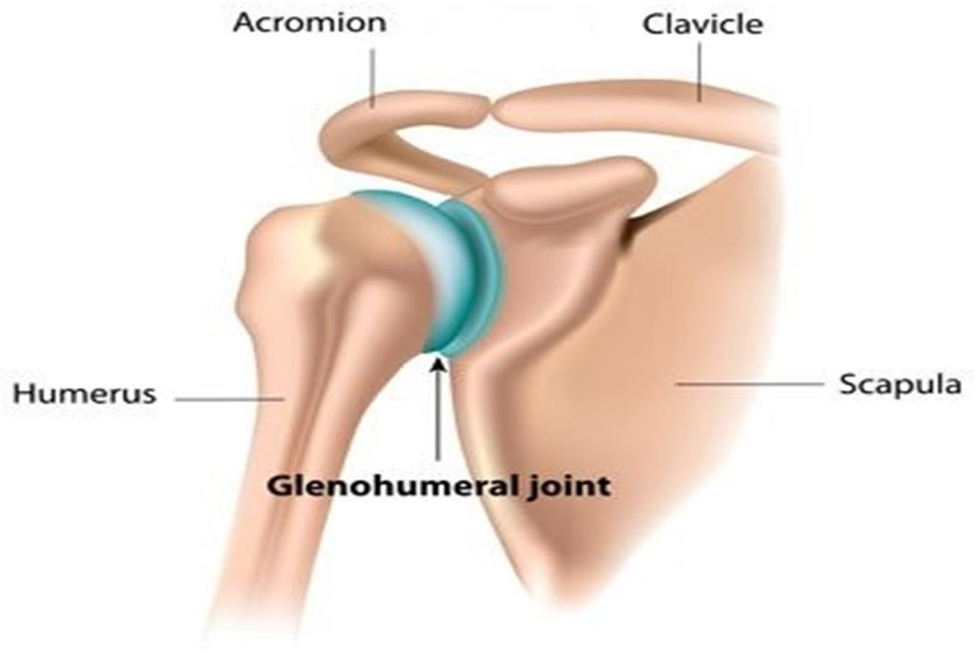
1. Type of the joint
Is a synovial ball-and-socket joint
The ball on the Humerus sits in the socket on the Scapula ‘The Glenoid cavity’
The ball does not fit exactly, which allows increased movement
Stability is provided by muscles & ligaments

Slide 19
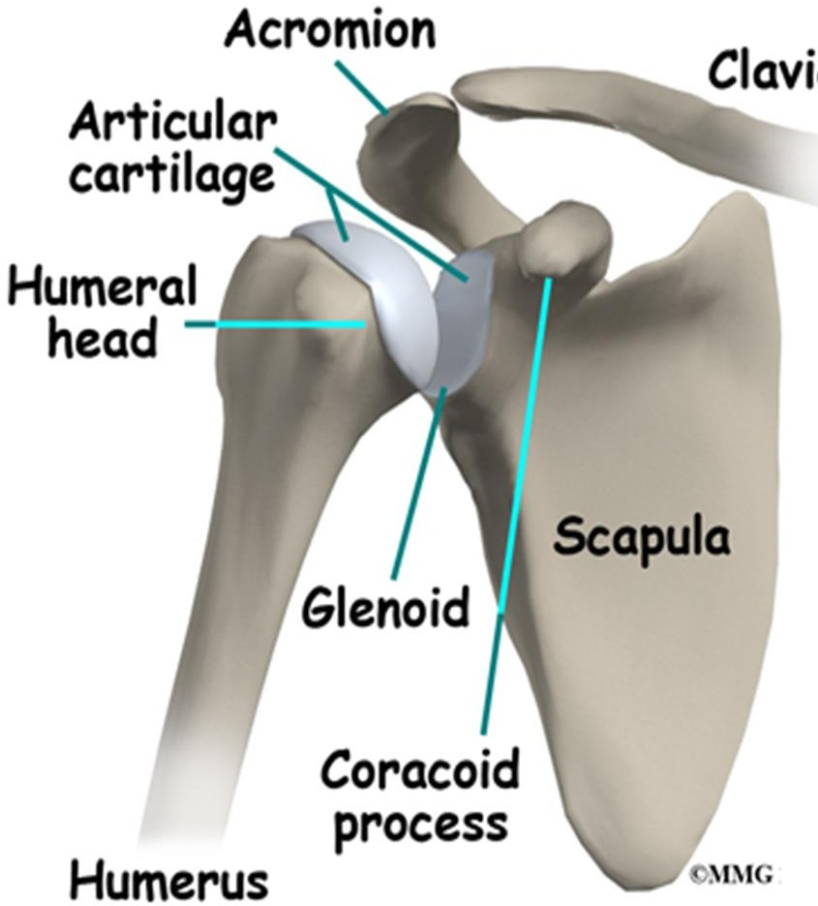
2. Articulation
Is between the rounded head of the humerus and the shallow, pear-shaped glenoid cavity of the scapula.
The articular surfaces are covered by hyaline articular cartilage for smooth gliding movement.

Slide 20
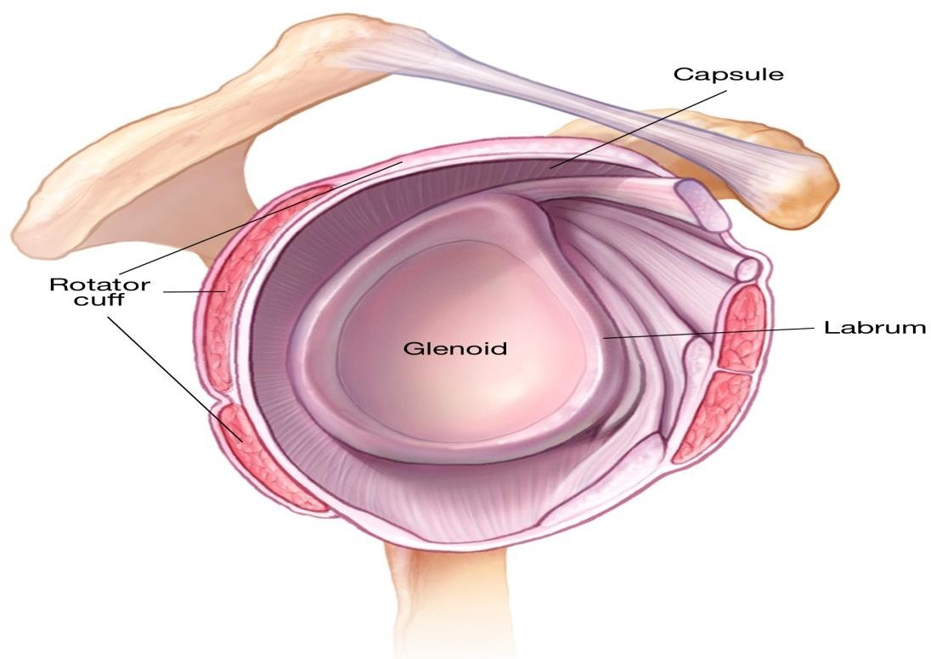
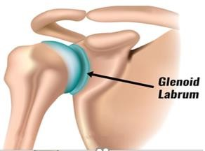
Glenoid cavity is deepened by the presence of a fibrocartilaginous rim called the glenoid labrum.
NB/ An injury to the shoulder can result in damage to the ‘Labrum- ’Labral tear

Slide 21
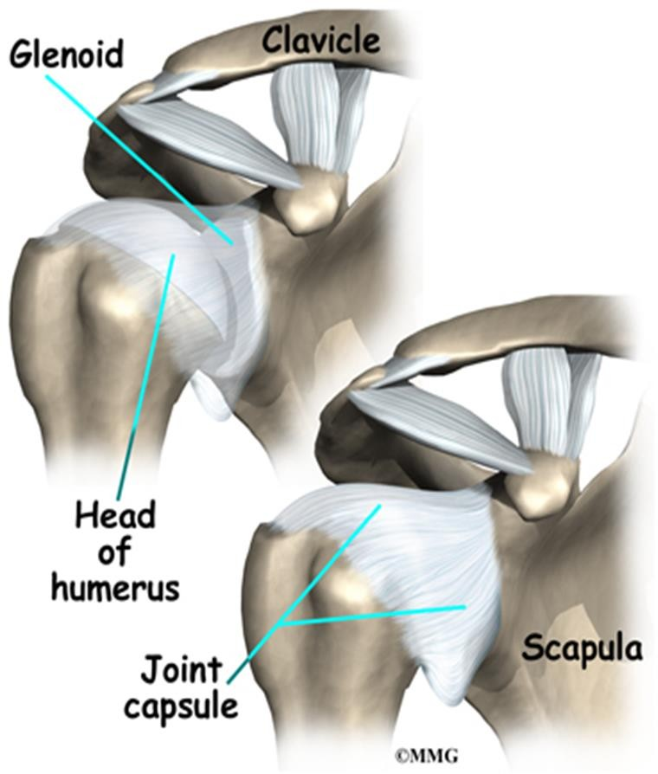
3. Joint Capsule
The joint capsule (dense fibrous connective tissue) surrounds the joint.
The capsule is thin and lax, allowing a wide range of movement
It is attached medially to the margin of the glenoid cavity outside the labrum
Laterally it is attached to the
anatomic neck of the humerus.

Slide 22
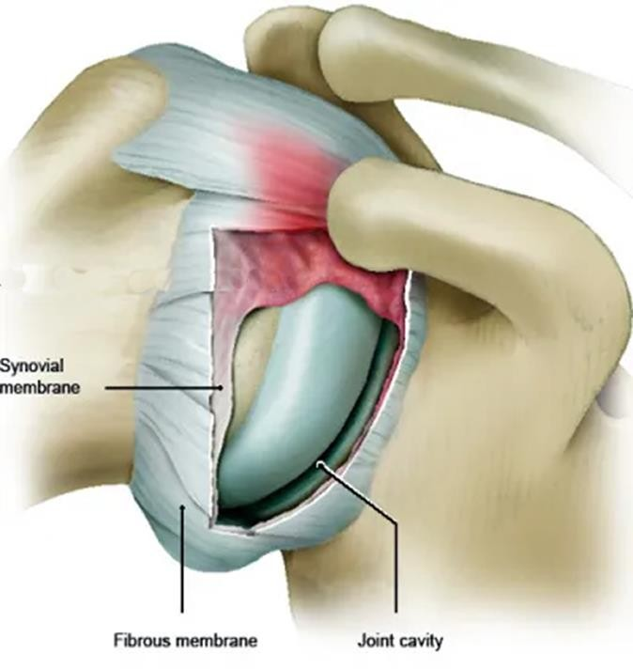
4. Synovial membrane
Is a thin membrane comprised of smooth connective tissue that secretes synovial fluid.
This lines the capsule from inside and is attached to the margins of the cartilage covering the articular surfaces
Its principal role is to reduce friction between the articular cartilage.

Slide 23
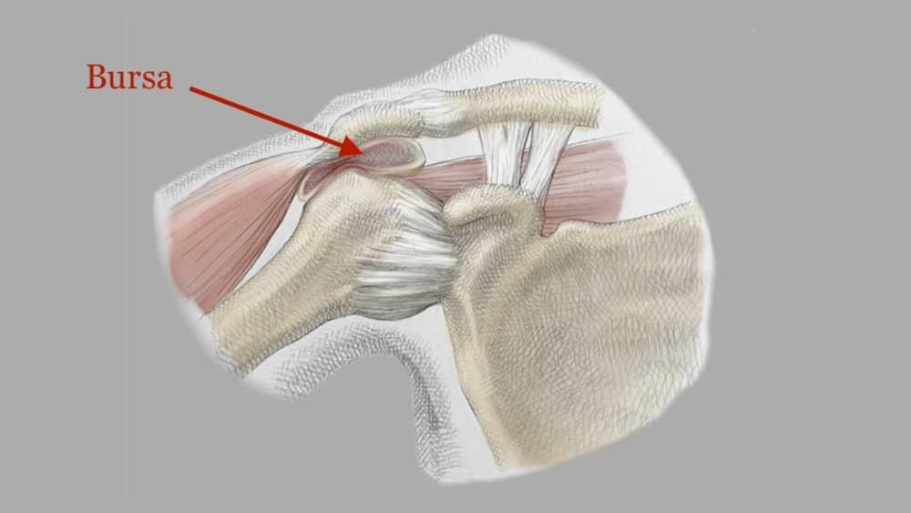
5. Bursa
Refers to sacs surrounding the shoulder joint that are filled with synovial fluid.
They facilitate movement and reduce friction at tendon- tendon and tendon-bone interfaces

Slide 24
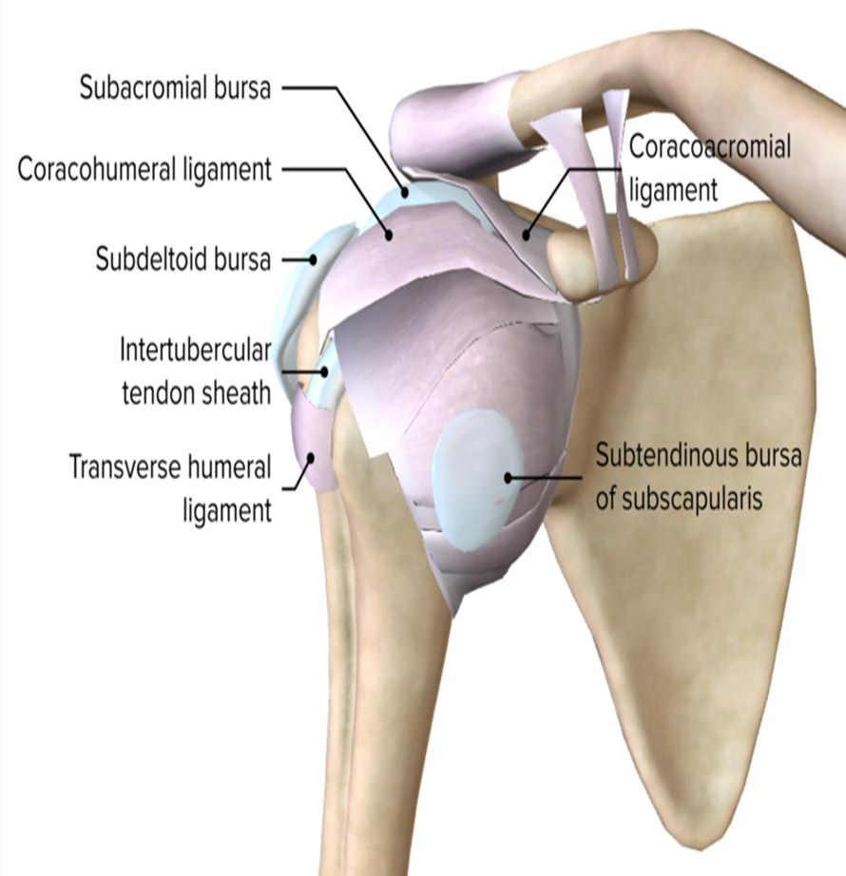
The major bursae in the shoulder are:
Subscapular bursa-between the tendon of the subscapularis muscle and the shoulder joint capsule.
Subacromial bursa- located inferior to the acromion and
superior to the supraspinatus and infraspinatus tendons
Subdeltoid bursa- located under the deltoid muscle.

Slide 25
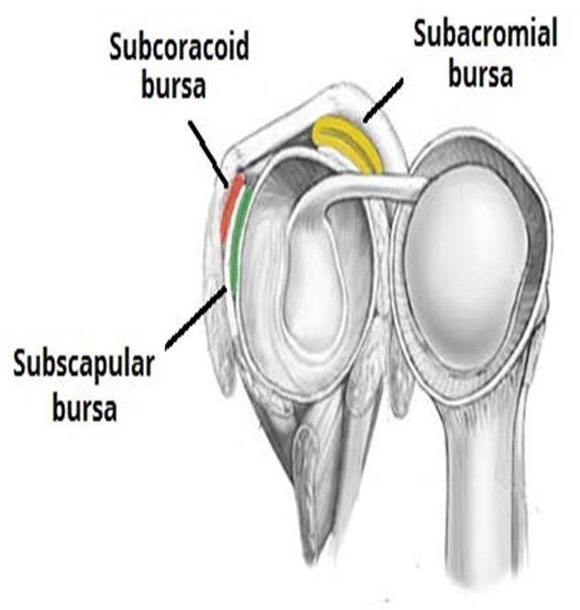
4. The sub-coracoid bursa
Is located between the anterior surface of the subscapularis and the coracoid process

Slide 26
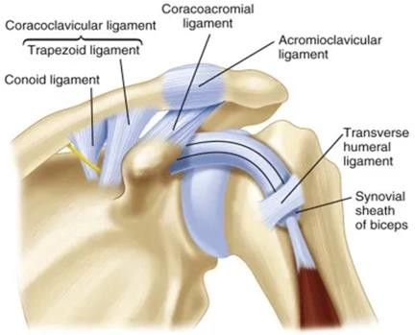
5. Ligaments
The glenohumeral ligaments are three bands of fibrous tissue that strengthen the front of the capsule.
1. Transverse humeral ligament
It strengthens the capsule and bridges the gap between the two tuberosities.

Slide 27
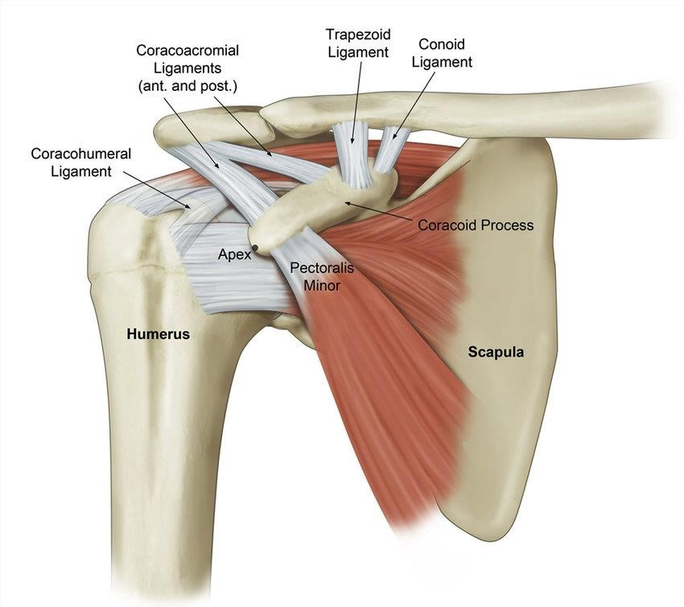
2. Coracohumeral ligament
Strengthens the capsule above and stretches from the root of the coracoid process to the greater tuberosity of the humerus.
3. Coracoacromial ligament
The coracoacromial ligament extends between the coracoid process and the acromion.
Its function is to protect the superior aspect of the joint.

Slide 28
7. Possible Movements of the gleno-humeral joint
Flexion: performed by the anterior fibers of the deltoid, pectoralis major, biceps, and coracobrachialis muscles.
Extension: by the posterior fibers of the deltoid, latissimus dorsi, and teres major muscles
Abduction: supraspinatus muscle initiates the movement of abduction (15⁰), then deltoid up to 90⁰and lastly trapezius assisted by serratus anterior beyond 90⁰
Adduction: This is performed by the pectoralis major, latissimus dorsi, teres major, and teres minor muscles.

Slide 29
Lateral rotation: Normal lateral rotation is 40° to 45°.
This is performed by the infraspinatus, the teres minor, and the posterior fibers of the deltoid muscle.
Medial rotation: by the subscapularis, the latissimus dorsi, the teres major, and the anterior fibers of the deltoid muscle.
Circumduction: This is a combination of the above movements.

Slide 30
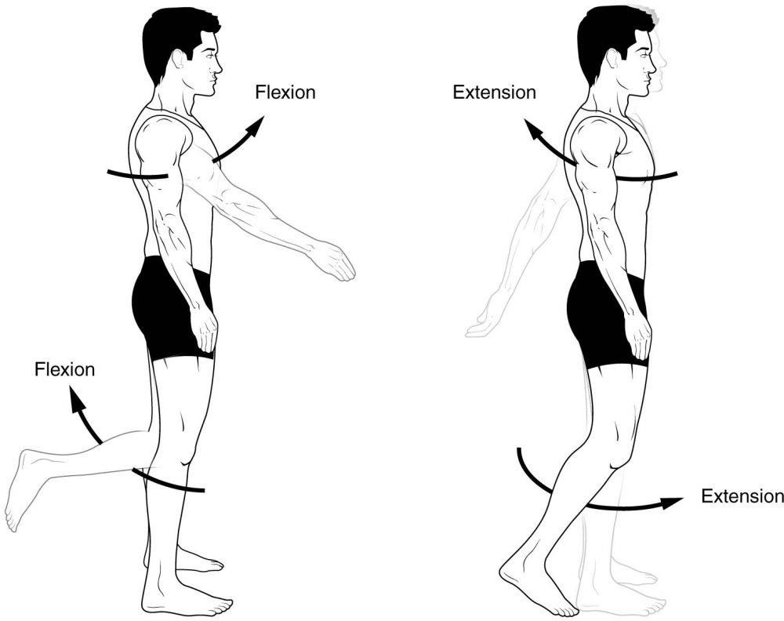
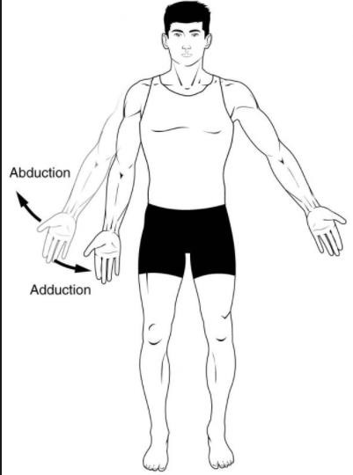
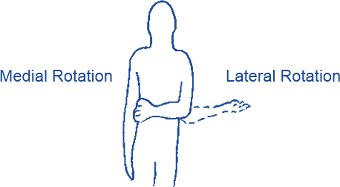

Slide 31
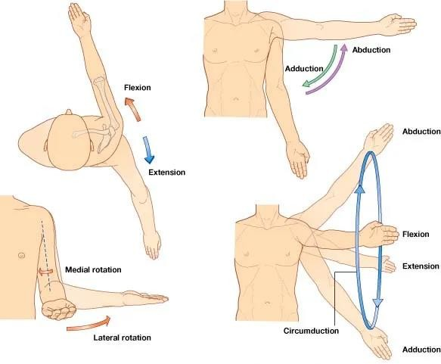

Slide 32
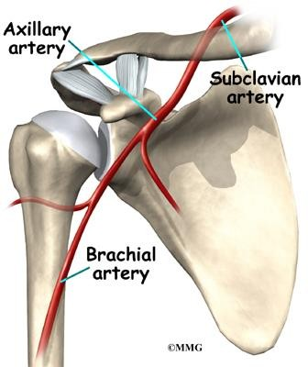
8. Blood supply
By branches of 3rd p of Axillary artery (posterior humeral C.A).

Slide 33
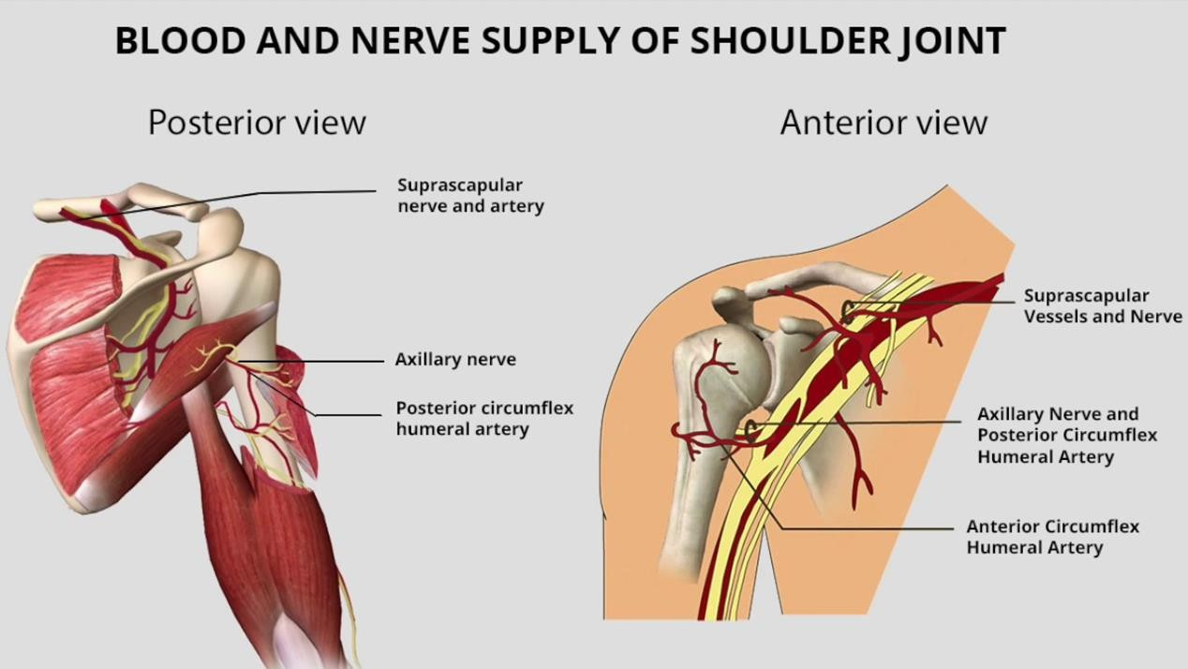
Nerve supply:
By the axillary and suprascapular nerves

Slide 34
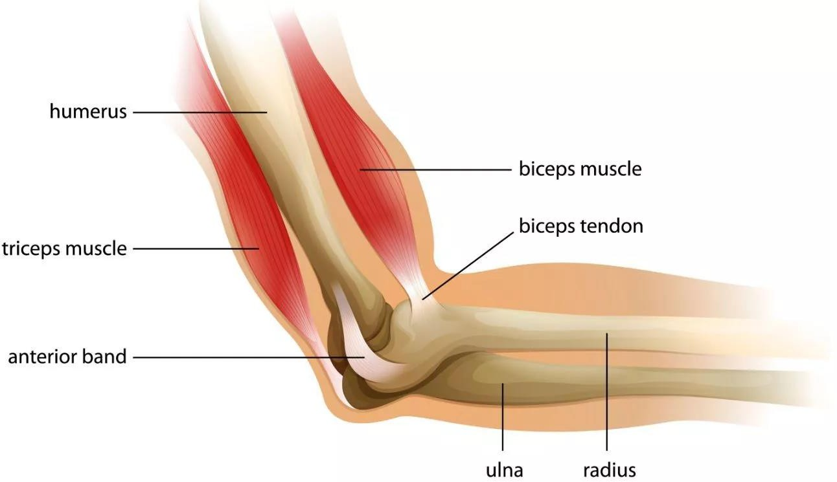
The Elbow Joint
1. Type of Joint
Synovial hinge joint
Allows motion primarily in one plane

Slide 35
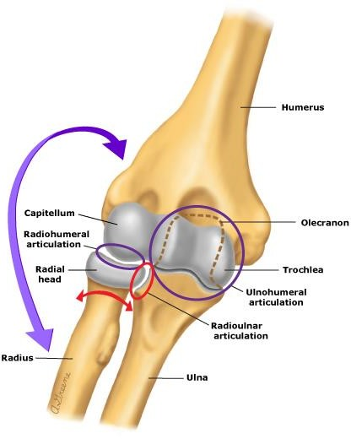
2. Articulation
Involves three bones –the humerus, radius and ulna.
Trochlear notch of the ulna and the trochlea of the humerus
Head of the radius and the capitulum of the humerus
Posteriorly, olecranon process of ulna and olecranon fosa of humerus

Slide 36
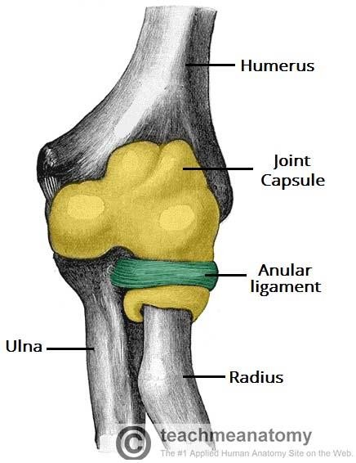
3. Joint Capsule
It surrounds the elbow joint
Is strong and fibrous, strengthening the joint.
It is thickened medially and laterally to form collateral ligaments, which stabilise the flexing and extending motion of the arm.
Anteriorly- it is attached above to the humerus along the upper margins of the coronoid and radial fossae and to the front of the medial and lateral epicondyles
Inferiorly-Is attached to the margin of the coronoid process of the ulna and the annular ligament

Slide 37
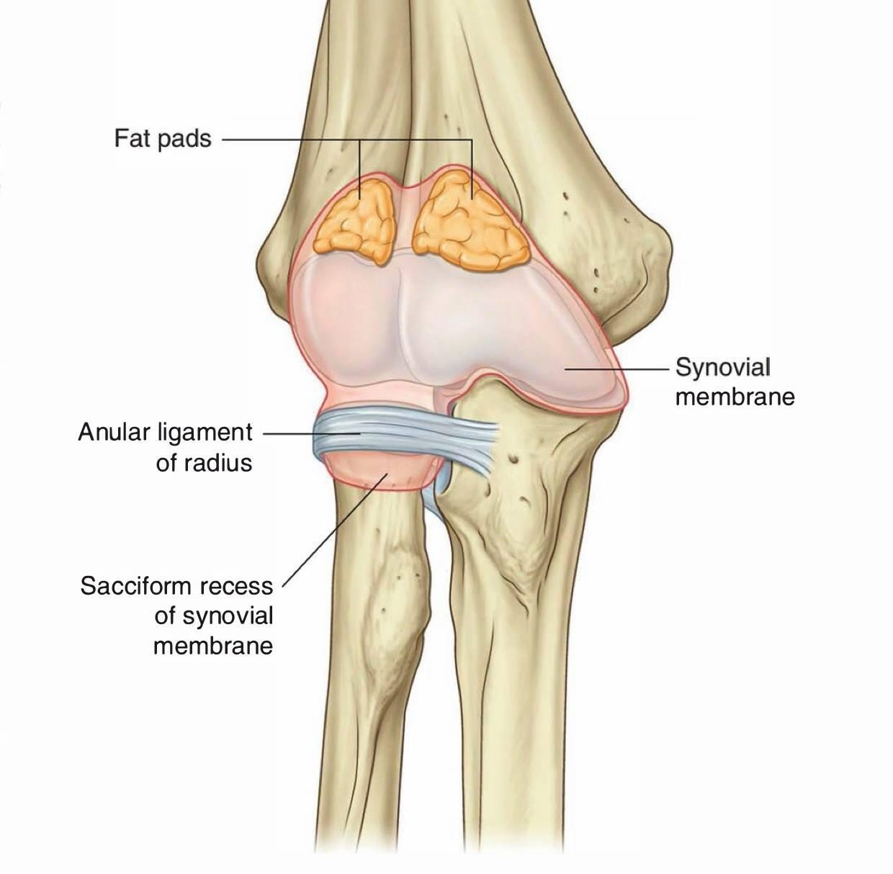
4. Synovial Membrane
It lines the inner surface of joint capsule and covers the fatty pads in the floors of the coronoid, radial, and olecranon fossae.

Slide 38
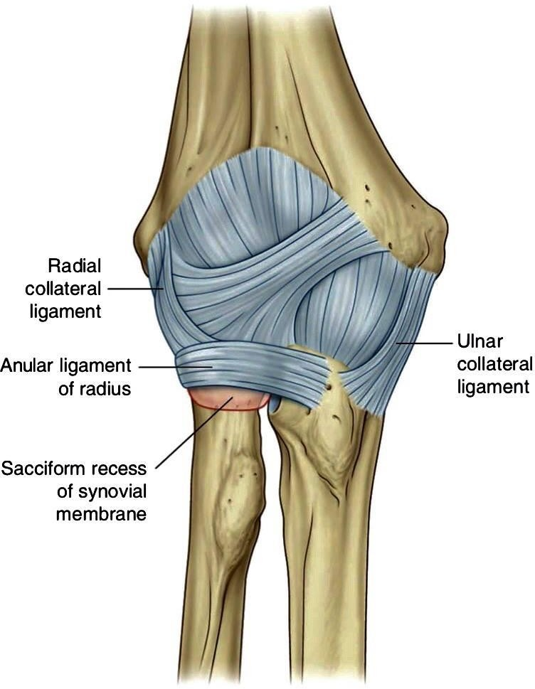
5. Ligaments
The joint capsule of the elbow is strengthened by ligaments medially and laterally.
The radial collateral ligament is found on the lateral side of the joint, extending from the lateral epicondyle, and blending with the annular ligament of the radius (a ligament from the proximal radioulnar joint).
The ulnar collateral ligament originates from the medial epicondyle, and attaches to the coronoid process and olecranon of the ulna.

Slide 39
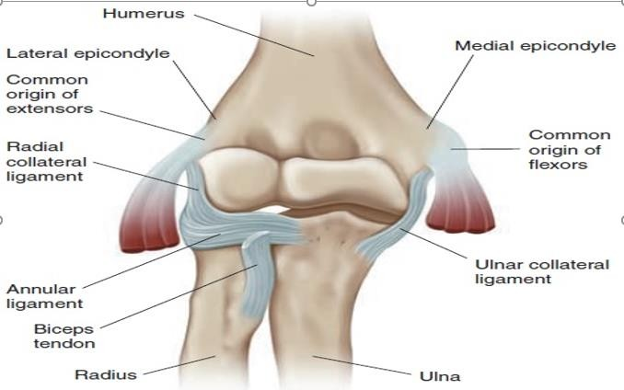

Slide 40
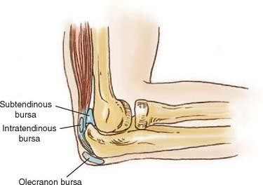
6. Bursae
Is a membranous sac filled with synovial fluid.
It acts as a cushion to reduce friction between the moving parts of a elbow joint, limiting degenerative damage.
There are many bursae in the elbow, but only a few have clinical importance:
1. Intra-tendinous triceps bursa – located within the tendon of the triceps brachii.

Slide 41

2. Sub tendinous triceps bursa– between the tip of olecranon and the tendon of the triceps brachii,
reducing friction between the two
and
structures during extension
flexion of the arm.
3. Subcutaneous (olecranon) bursa – between the olecranon and the overlying subcutaneous tissue

Slide 42
7. Possible Movements of the elbow joint
The orientation of the bones forming the elbow joint produces a hinge type synovial joint, which allows for extension and flexion of the forearm:
Extension – triceps brachii and Anconeus
Flexion – brachialis, biceps brachii, brachioradialis

Slide 43
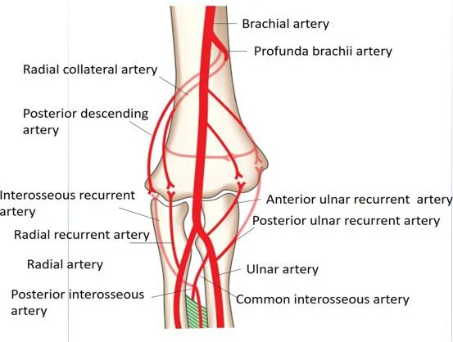
8. Neurovasculature The arterial supply
Elbow joint is supplied from the cubital/elbow anastomosis
Contributed by Brachial artery and profunda brachii artery
Brachial A-Superior ulna collateral
-Inferior ulna collateral
Profunda Brachii A
-Posterior descending (middle collateral) artery
- Anterior descending (radial collateral) artery

Slide 44
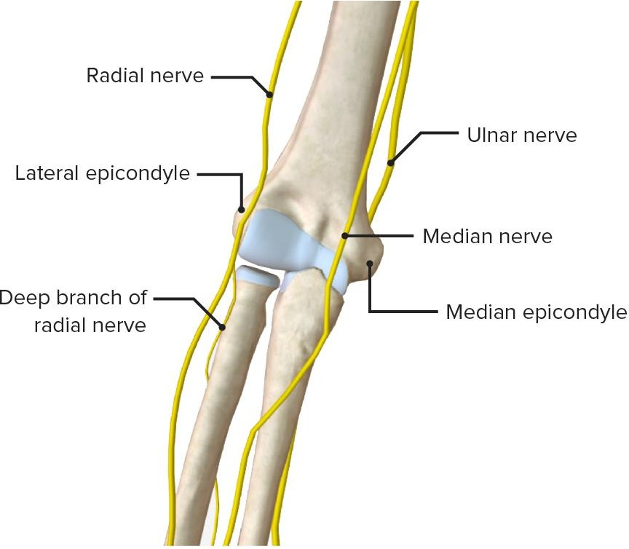
Innervation
Its nerve supply is provided by; the median, musculocutaneous
And radial nerves anteriorly, and the ulnar nerve posteriorly

Slide 45
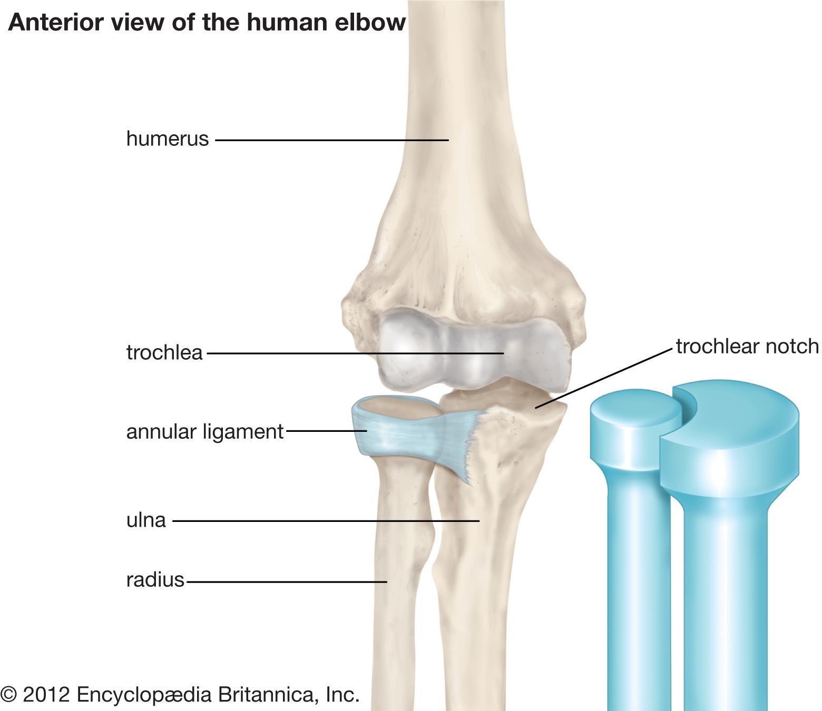
Proximal radio-ulna joints
1. Type of joint
Synovial pivot joint/ Rotatory joint
Permit axial rotation of head of radius within a ring formed by the concave surface on the radial notch of ulna.

Slide 46
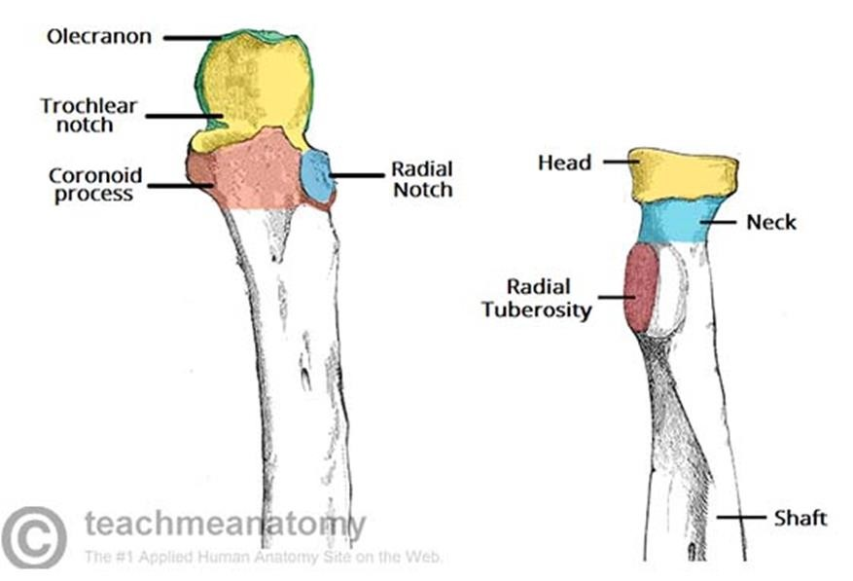
2. Articulation
Between the circumference of the head of the radius and the annular ligament with the radial notch on the ulna

Slide 47
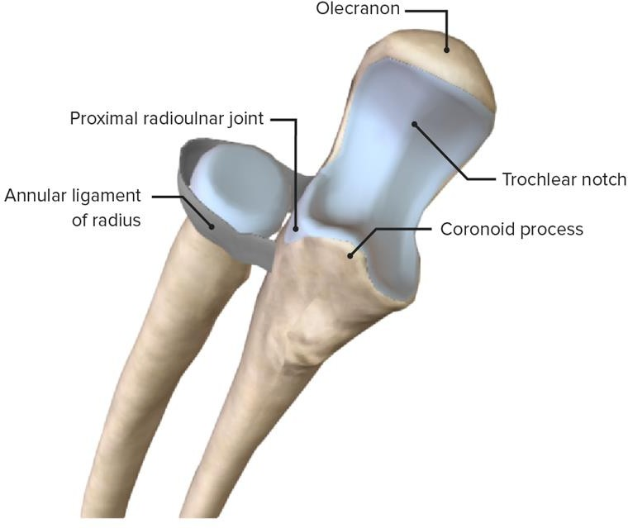

Slide 48
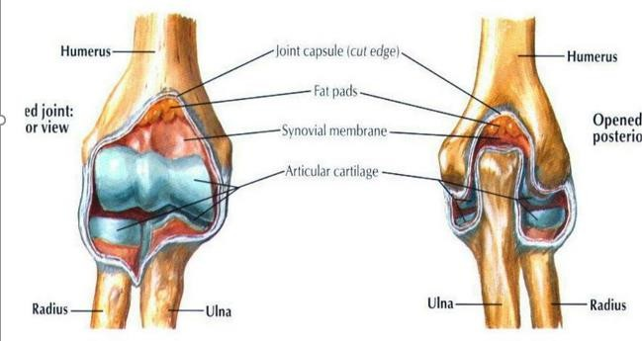
3. Joint Capsule
The capsule encloses the joint and is continuous with that of the elbow joint (is an extension of the elbow's joint capsule).

Slide 49
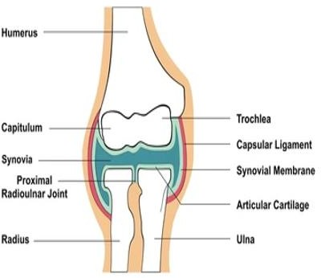
4. Synovial membrane
It lines the interior surface of the capsule, where it is continuous with the synovial membrane of the elbow joint.
Thus, the elbow and proximal radioulnar joints share one continuous synovial cavity.
Below, its attached to the inferior margin of the articular surface of the radius and the lower margin of the radial notch of the ulna and the annular ligament.

Slide 50
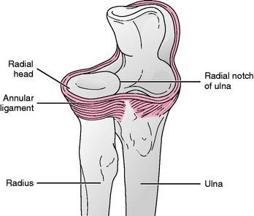
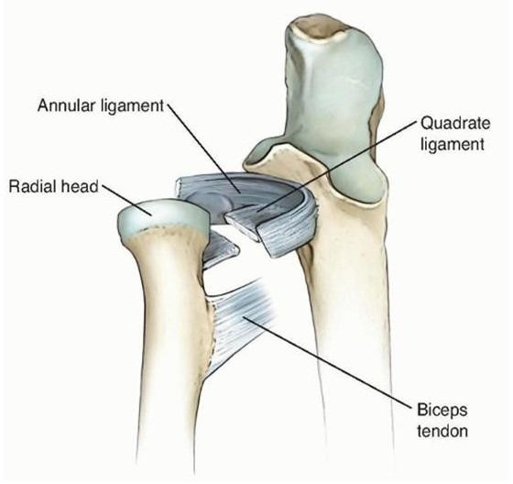
5. Ligaments
1. The annular ligament
Is attached to the anterior and
posterior margins of the radial
notch on the ulna and forms a
collar around the head of the radius
2. The quadrate ligament
Is a fibrous band attached to the inferior border of the radial notch on the ulna and to the neck of the radius.
Its borders are strengthened by fibers from the upper border of the annular ligament

Slide 51
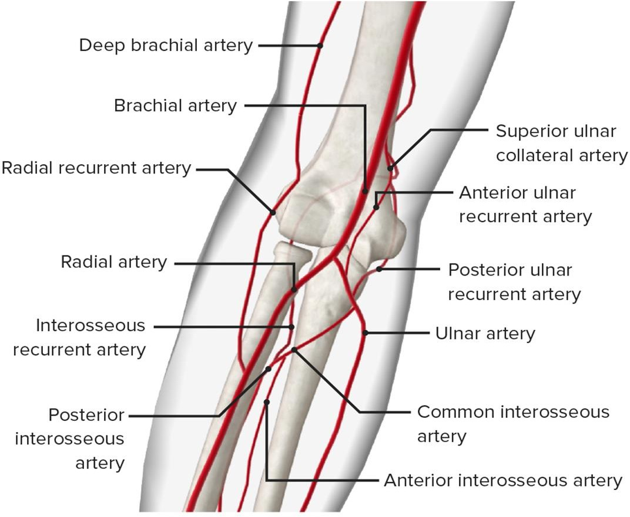
6. Blood supply
From the radial portion of the peri-articular arterial anastomosis of the elbow joint formed by;
i). The radial collateral branch of profunda brachial artery
ii) radial and recurrent branches of the radial
iii). common interosseous artery.

Slide 52
7. Nerve supply
Branches of the median, ulnar, musculocutaneous, and radial nerves

Slide 53
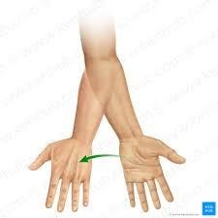
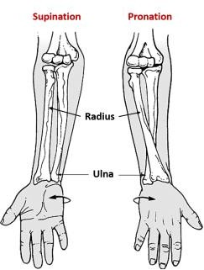
8. Possible movements
Supination- Supinator
Pronation-Pronator teres/ Pronator quodratus

Slide 54
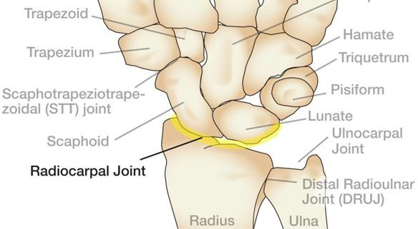
Distal/Inferior radio-ulna joints
1. Type of Joint
Is a synovial pivot joint

Slide 55

2. Articulation
Between the rounded head of the ulna and the ulnar notch on the radius
Articular disc: Is composed of fibrocartilage.

Slide 56

3. Joint Capsule
The joint is enclosed by a fibrous capsule that attaches to the margins of the articular surfaces.
The internal surface of the capsule is lined by a synovial membrane

Slide 57

4. Synovial membrane:
This lines the capsule passing from the edge of one articular surface to that of the other.
Secretes synovial fluid to reduce friction between the articular
cartilages.
5. Ligaments:
Anterior(palmer) and posterior(dorsal) ligaments strengthen the capsule

Slide 58

6. Blood supply
Is supplied by the palmar and dorsal branches of the anterior interosseous artery

Slide 59


7. Nerve supply:
Anterior interosseous nerve (median nerve), and the deep branch of the radial nerve (articular branch).

Slide 60

Possible movements
Pronation-Supination

Slide 61



Wrist Joint/Radio-carpal joint
1. Type of Joint
Synovial ellipsoid/condyloid joint
The oval-shaped condyle of one bone fits into the elliptical cavity of the other bone.

Slide 62

2. Articulation
The wrist joint generally refers to the radiocarpal joint, which is the articulation between the distal end of the radius and the articulating surface of the scaphoid, lunate, and triquetral bones.

Slide 63

3. Joint Capsule /Synovial membrane
The capsule encloses the joint and is attached above to the distal ends of the radius and ulna and below to the proximal row of carpal bones.
Synovial membrane lines the capsule and is attached to the margins of the articular surfaces.

Slide 64




4. Ligaments .
The four ligaments responsible for maintaining the stability of the joint are the palmar and dorsal radiocarpal ligaments and the ulnar and radial collateral ligaments
The medial ligament is attached to the styloid process of the ulna and to the triquetral

Slide 65

5. Blood supply
The major vessels that supply the wrist and hand are the ulnar and radial arteries

Slide 66

5. Nerve supply
Anterior interosseous nerve (median nerve) deep branch of the radial nerve and the perforating branches of the ulnar nerve
6. Possible Movements
Flexion, Extension, Abduction, Adduction

Slide 67
ASSIGNMENT
Read on the following joints
Intercarpal joints (ICJ)
Intermetacarpal joints (IMJ)
metacarpophalangeal joints (MCP)
Interphalangeal joints (IPJ)

